Slide 1


Car Warehouse Management System
Instructor: Sir Abdul Rehman
Mehmood
BCS-5A
K230907 ZUBAIR AHMED
K230516 USMAN KHALID
K230668 MUJTABA KHAN

Slide 2
Project Overview:
  Complete car dealership management solution
  Inventory tracking & sales management
  Customer relationship management
  Online vehicle catalog
  Brand affiliations & Partnerships

Slide 3
System Features
Inventory Tracking
Efficient inventory tracking ensures real-time visibility of stock levels, simplifying management and reducing errors within the warehouse operations.
Key functionalities of the management system:
Real-Time Monitoring
Real-time monitoring allows for immediate updates on inventory status, enabling quick decision-making and enhancing overall operational efficiency.
Automated Storage
Automated storage systems streamline the retrieval process, maximizing space utilization and improving access to vehicles within the warehouse environment.

Slide 4
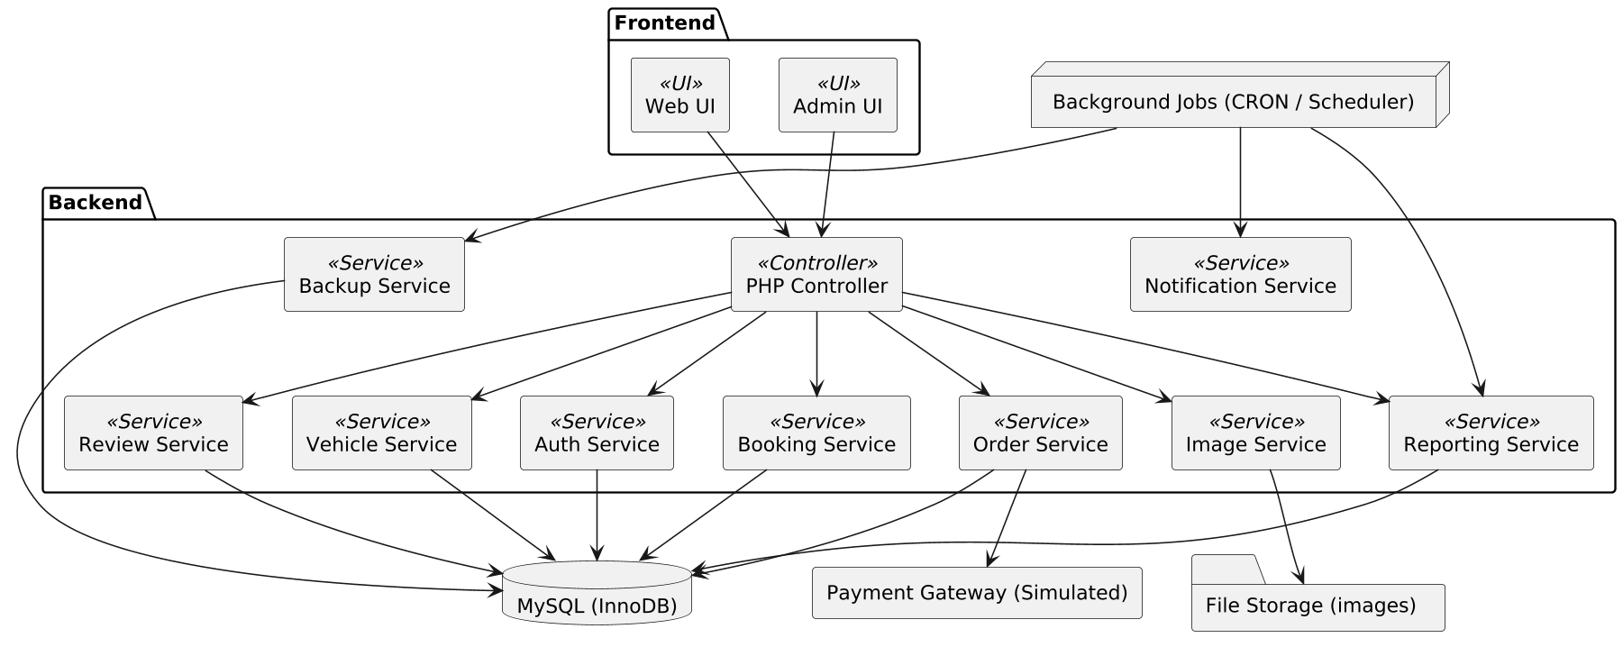
Architecture:

Slide 5
System Requirements:
Enhancing Efficiency and Security
User Management
Car Inventory Management
Dashboard & Reports
  Users can register and log in.
  Admin can manage user accounts.
  Add new car details
  Edit existing car information
  Delete car records
  Display total cars, available slots, and trending vehicles.
  Generate reports on inventory, orders.
Car & Brand Management
Customer Interaction & Booking
  Display total cars, available slots, and trending vehicles.
  Generate reports on inventory, orders, and test drives.
  Customers can search/filter vehicles, view galleries, and Buy.
  Maintain order history and manage customer reviews.

Slide 6
System Actors:
Primary Actors:
Admin
Customer/User
  Users can register and log in.
  Admin can manage user accounts.
  Browses vehicles, filters by price/type/year
  Views galleries & specifications
  Books test drives
  Gives reviews
Secondary Actors:
Manufacturer / Brand Partner
System Database
  Provides brand details, affiliations, and manufacturing info
  Stores all car, user, inventory, and order data

Slide 7
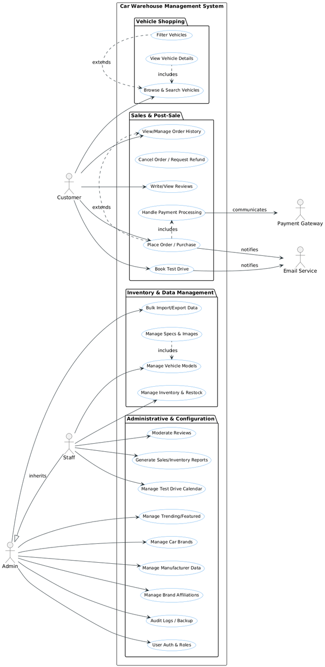
USE CASE DIAGRAM:

Slide 8
Detailed Use Cases
Use Case 1: Manage Car Models
Use Case 2: Search & Filter Vehicles
Use Case 3: Test Drive Booking
Actor: Admin
Pre-condition: Admin is logged in
Post-condition: Model is created/updated/deleted
Main Flow:
  Admin selects “Car Model Management”
  Enters model info (price, manufacturing details, type)
  Saves changes
Alternate Flow:
– Missing fields → system shows validation errors
Actor: Customer
Pre-condition: Customer opens website
Post-condition: Vehicles displayed as per selected filters
Main Flow:
  Customer enters keyword or selects filters
  System displays filtered results
Alternate Flow:
– No matching vehicles → “No results
Actor: Customer
Pre-condition: Customer selects a car
Post-condition: ooking saved and visible to Admin
Main Flow:
  Customer clicks “Book Test Drive”
  Selects date/time
  System confirms booking
Alternate Flow:
– Slot unavailable → User selects another date

Slide 9
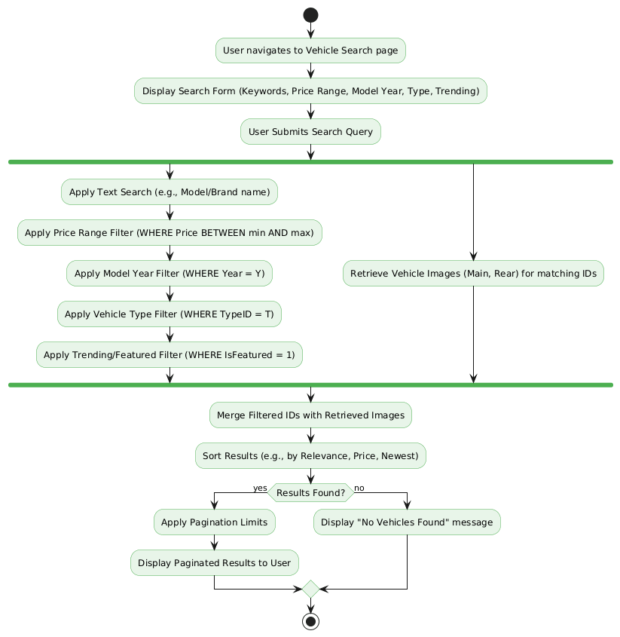
Activity Diagram:
For Searching Cars:

Slide 10
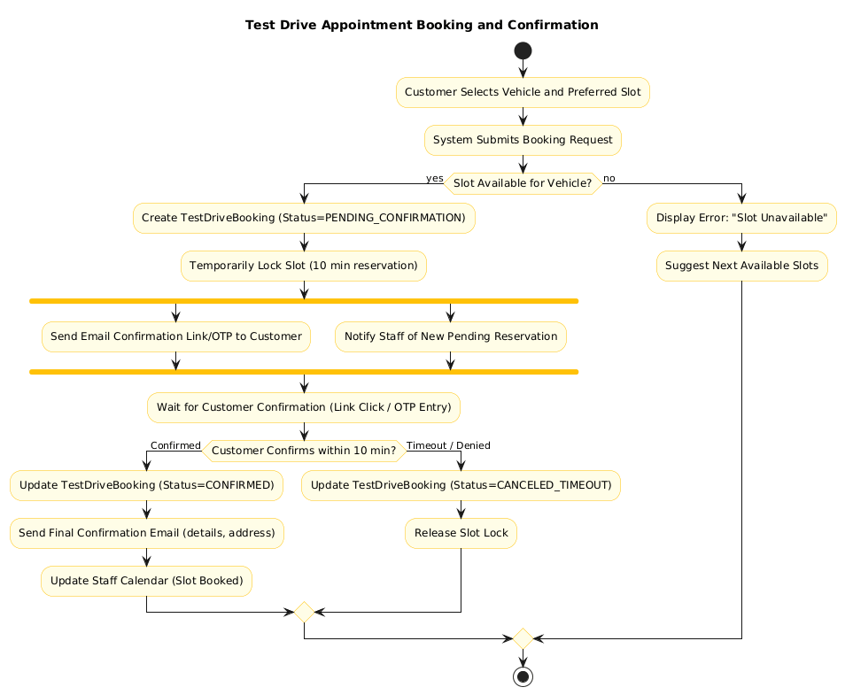
Activity Diagram:
Test-Drive Booking:

Slide 11
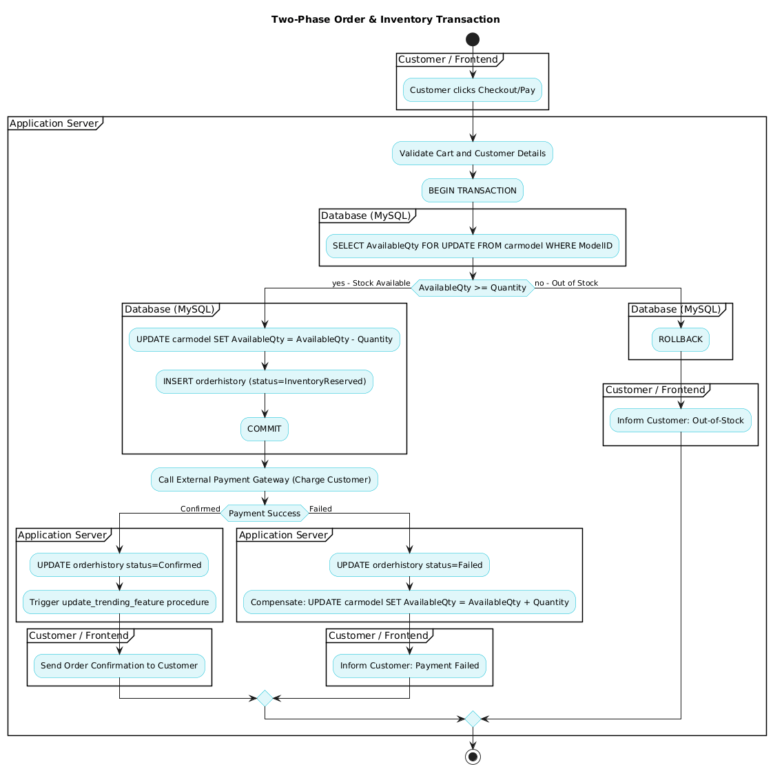
Activity Diagram:
Order and Inventory Transaction:

Slide 12
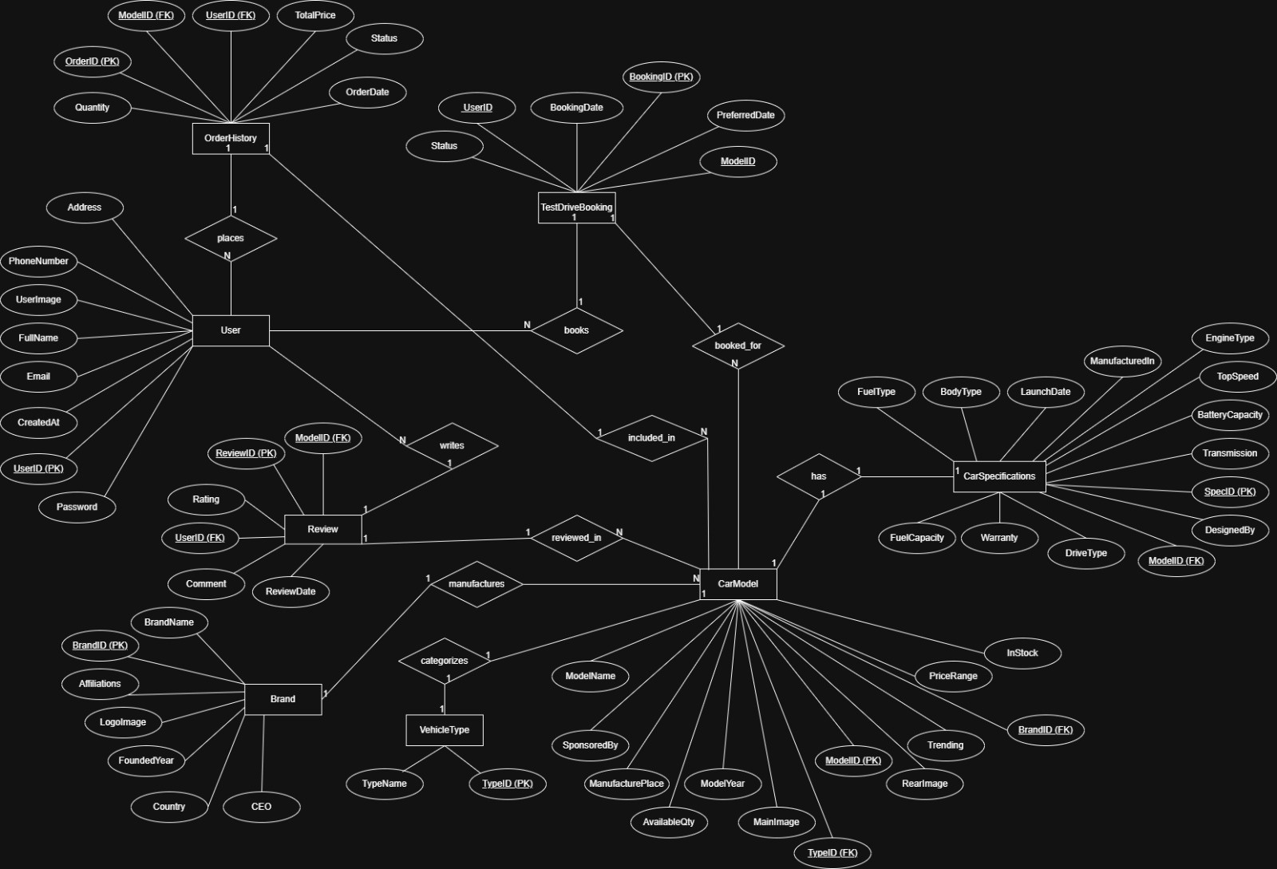
ERD Diagram:

Slide 13
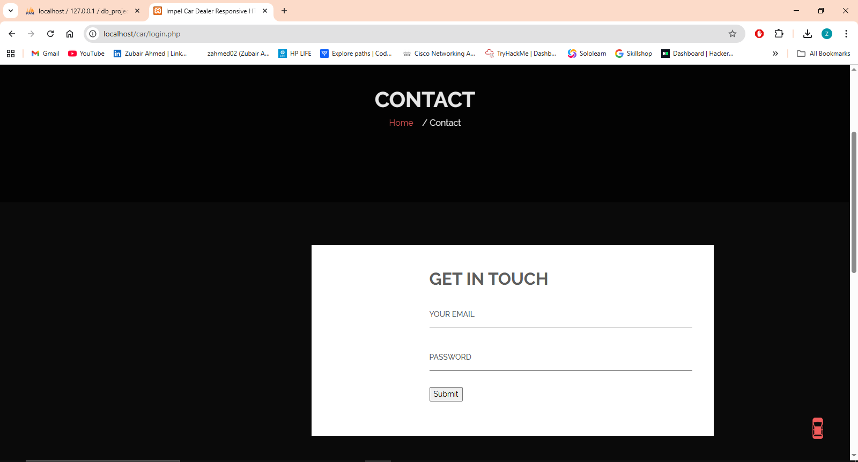
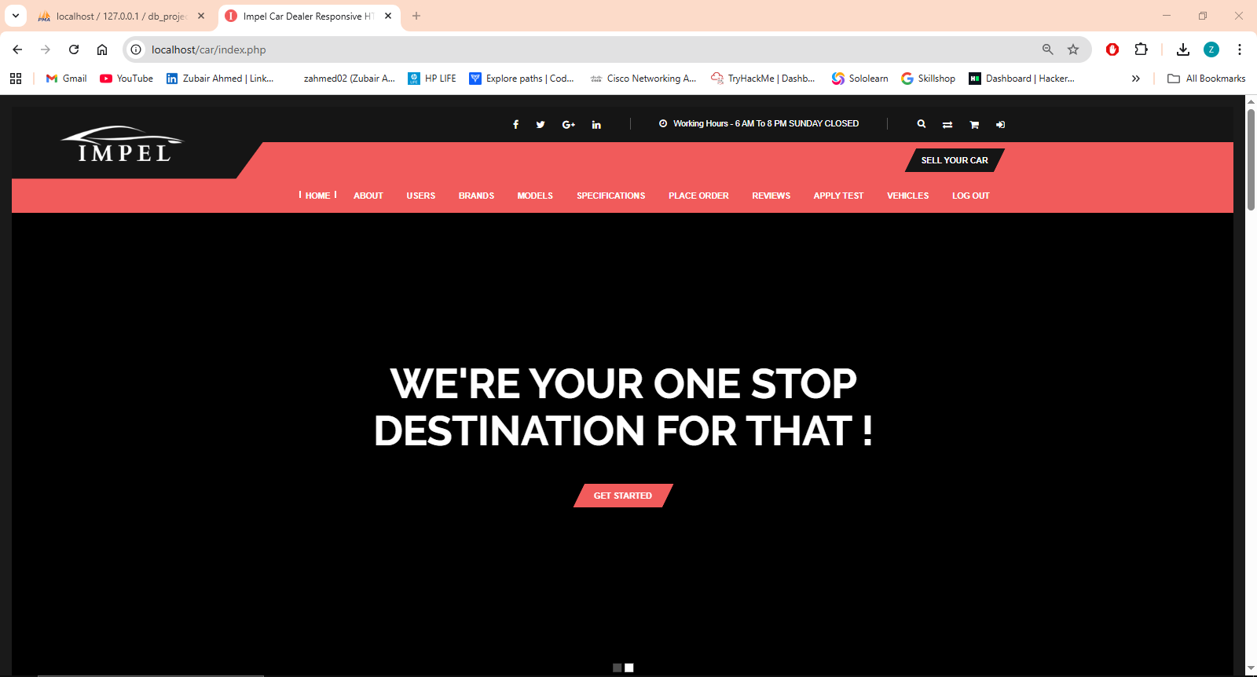
UI Screen Shots:
Login Page:
Home Page:

Slide 14
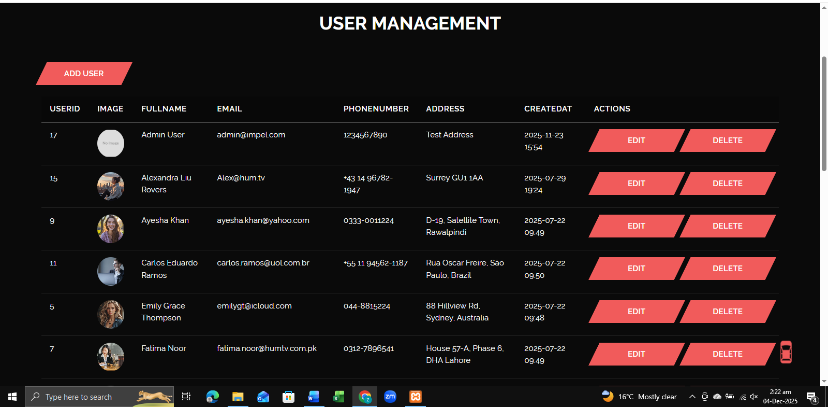
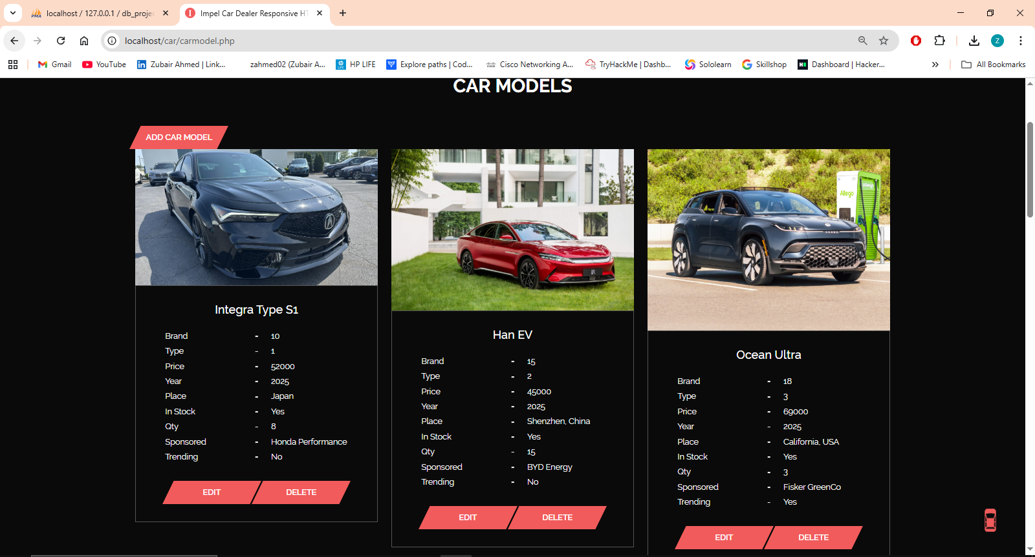
UI Screen Shots:
Users:
Car Models:

Slide 15

Conclusion:
  System centralizes all car warehouse operations
  Improves accuracy through real-time inventory tracking
  Enhanced user experience with gallery, filters & reviews
  Supports test drive scheduling and order history tracking
Future Enhancements:
  AI-based recommendation engine
  Automated price comparison
  Integration with real dealership APIs
  Mobile app version

Slide 16
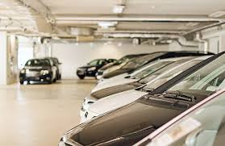
Any Questions About This?
Thank You!

